Slide 2
WELCOME
April 6, 2024
SPAPN 2024 Spring Conference

Slide 3
Criteria for Awarding Contact Hours
The entire session must be attended, and all requirements must be met to receive credit.
The Planning Committee, presenter and content reviewers have no relevant or financial conflict of interest to disclose.
There is no commercial support for this program.
2.75 CEUs which includes for pharmacology is approved to AANP for accreditation.
Successful Completion

Slide 4
EXHIBITORS

Slide 5
Executive Board
President Louise Gabriele
Vice President Shavar Chase
Secretary Beth Teal
Education Director Kathleen Prendergast
Treasurer (Interim) Louise Gabriele
Public Affairs Jessica Costa
Legislative Affairs Marcel Kaganovskaya
Membership Co Chair Deb Drumm
Nominating/Awards Deb Drum
Webmaster Casandra Gabriele

Slide 6
AGENDA
830 am Sign in
9 am Steven Harrison, MD
Psychotropic and Cardiac Complications
10:15 am Veronica Jenson, DNP, PMHNP
Psychotic Symptoms and Treatment A Case Study Approach
11:00 am Dorothy Borresen, PhD, PMHNP
Antidepressant Decision Making
12 noon Lunch
1230 pm SPAPN General Meeting
Legislative Update

Slide 7
The Society of Psychiatric of Advanced Practice Nurses
Our Mission
Our Purpose
To foster excellence in psychiatric advanced practice nursing
To provide ongoing support to our members

Slide 8
Our Goals
To advocate high quality professional care to clients, their families and the community by:
Promoting professional development through continuing education, networking, award recognition.
Providing member support through peer supervision and mentoring.
Enhancing communication and professional collaboration among healthcare providers.
Educating consumers regarding issues of mental health.
Monitoring trends and needs in mental healthcare and influencing public policy.

Slide 9
Business Meeting
I. Call to Order
II. Approval of the Agenda
III. Approval of the Minutes for last General Meeting
Executive Board reports
Old Business
Trends in Legislation
V. New Business
Board Actions
Bylaw update
VII. Adjournment

Slide 10
MEMBERSHIP
Co Chair
Shavar Chase & Deb Drumm
117 Active Members
5 Lifetime members
66 Student Members

Slide 11
CONFERENCES
Education Director
Kathleen Prendergast
Committee includes
Jessica Costa,
Dorothy Borresen,
Veronica Jenson

Slide 12
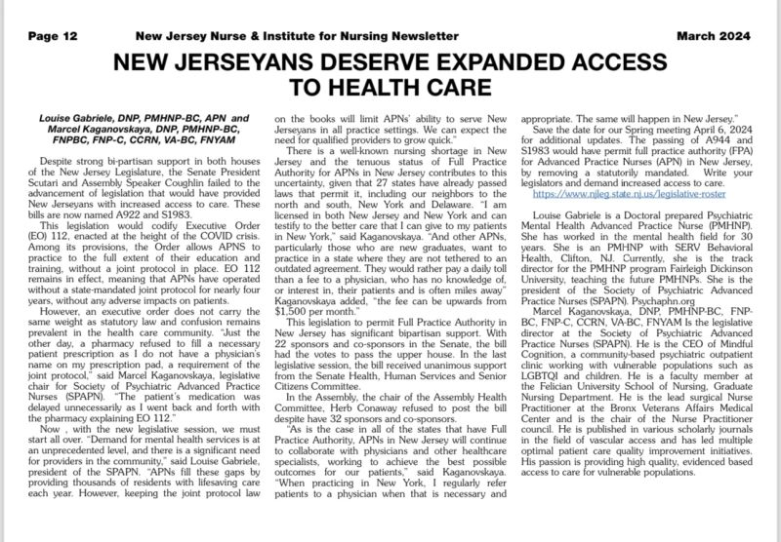
Public Affairs Report Jessica Costa

Slide 13
Press Release
December 11, 2023
NEW JERSEYANS DESERVE EXPANDED ACCESS TO HEALTH CARE
Legislature Must Consider and Pass Bill to Allow Advanced Practice Nurses to Serve their Patients without Barriers
Despite strong bi-partisan support in both houses of the New Jersey Legislature, the Senate and Assembly continue to stall the advancement of legislation that will provide New Jerseyans with increased access to care, particularly for mental health. S1522 and A2286 permit full practice authority (FPA) for Advanced Practice Nurses (APN) in New Jersey, removing a statutorily mandated, purely contractual agreement between each APN and a physician, also known as a joint protocol. The bill is not on the Senate Board list or on the Assembly Health Committee agenda for today, Monday, December 11. These are the next steps necessary for passage in each house.
“Demand for mental health services is at an unprecedented level, and there is a significant need for providers in the community,” said Louise Gabriele, president of the Society of Psychiatric Advanced Practice Nurses (SPAPN). “APNs fill these gaps by providing thousands of residents with lifesaving care each year. However, keeping the joint protocol law on the books will limit APNs’ ability to serve New Jerseyans in all practice settings.” She added, “in New Jersey, over 60% of psychiatrists are over 60 years old so we can expect the need for qualified providers to grow quick.”
This legislation would codify Executive Order (EO) 112, enacted at the height of the COVID crisis. Among its provisions, the Order allows APNS to practice to the full extent of their education and training, without a joint protocol in place. EO 112 remains in effect, meaning that APNs have operated without a state-mandated joint protocol for over three and a half years, without any adverse impacts on patients. However, an executive order does not carry the same weight as statutory law and confusion remains prevalent in the health care community. “Just the other day, a pharmacy refused to fill a necessary patient prescription as I do not have a physician’s name on my prescription pad, a requirement of the joint protocol,” said Marcel Kaganovskaya, legislative chair for SPAPN. “The patient’s medication was delayed unnecessarily as I went back and forth with the pharmacy explaining EO 112.”
There is a well-known nursing shortage in New Jersey and the tenuous status of Full Practice Authority for APNs in New Jersey contributes to this uncertainty, given that 27 states have already passed laws that permit it, including our neighbors to the north and south, New York and Delaware. “I am licensed in both New Jersey and New York and can testify to the better care that I can give to my patients in New York,” said Kaganovskaya. “And other APNs, particularly those who are new graduates, want to practice in a state where they are not tethered to an outdated agreement. They would rather pay a daily toll than a fee to a physician, who has no knowledge of, or interest in, their patients.” Kaganovskaya added, “the fee can be upwards from $1,500 per month.”
This legislation to permit Full Practice Authority in New Jersey has significant bipartisan support. With 22 sponsors and co-sponsors in the Senate, S1522 has the votes to pass the upper house. It has already received unanimous support from the Senate Health, Human Services and Senior Citizens Committee. In the Assembly, A2286 currently has 32 sponsors and co-sponsors.
“As is the case in all of the states that have Full Practice Authority, APNs in New Jersey will continue to collaborate with physicians and other healthcare specialists, working to achieve the best possible outcomes for our patients,” said Kaganovskaya. “When practicing in New York, I regularly refer patients to a physician when that is necessary and appropriate. The same will happen in New Jersey.”
Please visit the New Jersey Collaborating Center for Nursing (NJCCN) Access to Care Impact page for a variety of short testimonials in support of Full Practice Authority, particularly video number six, provided by Dr. Vincente Gracias, a physician and professor in the Department of Surgery at Robert Wood Johnson Medical School.

Slide 14
NEED YOUR HELP
NOMINATIONS SUGGESTIONS
AWARD SUGGESTIONS
Contact
Deb Drumm
Or
psychapn.org

Slide 15
Treasurer’s Report
As of 4/01/2024
Checking acct $17,256.84
PayPal $0
Morgan Stanley $13251.50
Total assets: $30508.34

Slide 16
EXPENSES 2024
AANP $450
CEU application fees $ 450
Award trophies $250
Webmaster fees $6000
Website $1815
Web design fee $1500
Ring Central $416
Stationary expenses $ 100
Porzio $12,000
Legal and professional fees $3000
Speaker Honorariums $1000
Miscellaneous $1000
Spring Conference venue $1000.00
Fall Conference venue $11000.00
Total Expenses $51981.00

Slide 17
Anticipated Income 2024
Membership $ 17750
Conferences $ 10000
Donations $ 1000
Exhibitors $ 12000
Total $40750

Slide 18
BUDGET
Anticipated Income $40750
Anticipate Expenses $51981
Short fall - $11231

Slide 19
Legislative Update
Marcel Kaganovskaya & Louise Gabriele

Slide 20
Full Practice
Reduced Practice
Restricted Practice
New Jersey
Regulatory Structure: Reduced Practice
New Jersey constrains nurse practitioner (NP) licensure and practice. New Jersey NPs must maintain joint protocols with a collaborating physician to order medications and devices. See the Board of Nursing for more information. N.J.S.A. 45:11-49.
27 States have FPA

Slide 21
New Jersey State Policy
Executive Order 112
No need for a Joint Protocol

Slide 22
In Summary
If an order (EO 112) or rule waiver is rescinded, the Murphy administration will provide off-ramps and time for affected stakeholders to comply with the change and not just have it take effect immediately.

Slide 23
End of Federal Public Health Emergency
May 11, 2023
Governor’s Office Response: Thank you for your inquiry. As you are aware, there is a different jurisdictional scope between the federal public health emergency and our state level response to COVID-19. EO 103, which took effect on March 9, 2020, declared a public health emergency and state of emergency in New Jersey. The initial public health emergency, which was extended every 30 days over the course of 2020 and 2021, officially ended when EO 244 was signed on June 4, 2021. The Governor declared a new public health emergency due to emerging COVID-19 variants on January 11, 2022 pursuant to EO 280 that was extended for 30 days, but ultimately lifted on March 4, 2022 pursuant to EO 292.
The state of emergency, however, remained – and continues to remain – in effect pursuant to EO 103 and EO 292. Our state regulatory actions, rule waivers, and directives from state departments are tied to the state of emergency, and therefore, in most instances, will not automatically expire with the expiration of the federal public health emergency. However, the Governor’s Office is in the process of evaluating the status of all our state COVID-19-related policies, including how they will be impacted by the federal government’s ending of the federal public health emergency.

Slide 25
ACTIVISM

Slide 26
S1983 Primary Sponsors & Cosponsors
Sponsors
Co-Sponsors
Vitale, Joseph F.
Singleton, Troy
Diegnan, Patrick J., Jr.
Zwicker, Andrew
Cryan, Joseph P.
Stack, Brian P.
Cruz-Perez, Nilsa I.
Beach, James
Johnson, Gordon M.
Turner, Shirley K.
O'Scanlon, Declan J., Jr.
Greenstein, Linda R.
Ruiz, M. Teresa
Burgess, Renee C.
Holzapfel, James W.
Steinhardt, Douglas J.
Testa, Michael L., Jr.
2023
Unanimously PASSED the Senate Health Committee in
Now new session
and
must start over

Slide 27
Primary Sponsors & Cosponsors
SENATE S1983
Senator President Nicholas Scutari
17
Need 21
D22
The district includes the Somerset County municipality of North Plainfield; and the Union County municipalities of Clark, Cranford, Fanwood, Linden, Plainfield, Rahway, Roselle Park, Scotch Plains and Winfield Township

Slide 28
A944 Primary Sponsors & Cosponsors
Sponsors
Co-Sponsors
Mbñoz, Nancy F. (R)
Spearman, William W. (D)
Quijano, Annette (D)
Reynolds-Jackson, Verlina
Sumter, Shavonda E.
Lopez, Yvonne
Moen, William F., Jr.
DeAngelo, Wayne P.
Stanley, Sterley S.
Murphy, Carol A.
DePhillips, Christopher P.
Clifton, Robert D.
Karabinchak, Robert J.
Scharfenberger, Gerry
Dunn, Aura K.
Speight, Shanique
Atkins, Reginald W.
Carter, Linda S.
Haider, Shama A.
Sauickie, Alex
Park, Ellen J.
Wimberly, Benjie E.
Barlas, Al
Miller, Cody D.
Calabrese, Clinton
Bailey, David, Jr.
Schnall, Alexander
Katz, Andrea
Rodriguez, Gabriel
Assemblyman
Herb Conaway (D)
Will not post the bill in
the
Health Committee

Slide 29
Primary Sponsors & Cosponsors
ASSEMBLY A944
Assembly Speaker Craig Coughlin
29
Need 41
D19
The district includes the Middlesex County municipalities of Carteret, Perth Amboy, Sayreville, South Amboy, and Woodbridge Township.

Slide 31
Board Actions
Executive Board welcomes student representation
Leadership opportunity in training
Submit interest to Psychapn@gmail.com

Slide 32
NEW INITIATIVES Coming Soon
Credit Card Payment System
Monthly ZOOM peer supervision
Premium Membership
Preceptor Assistance
Contact Psychaphn@gmail.com

Slide 33
Next Annual Meeting
FALL 2024
Spring Conference April 2025

Slide 34
THANK YOU FOR COMING
See you in November
Louisegabriele@gmail.com

Slide 35
VIDEOS
https://njccn.org/apn-videos/

